Slide 1

BASIC UNDERSTANDING OF
AI-2

Slide 2
01
01

Slide 3
NEURAL NETWORK
Neural Networks?
Neural networks are algorithm inspired by the structure of the human brain, Artificial Neural Networks(ANN).
What is CNN( Convolutional Neural Network)?
This is a type of Artificial Neural network that is used in supervised learning for analyzing imagery.
What is RNN( Recurrent Neural Network)?
This is an artificial neural network used in sequential data analysis. Used in speech recognition
Eg,Siri, Google search.
02

Slide 4
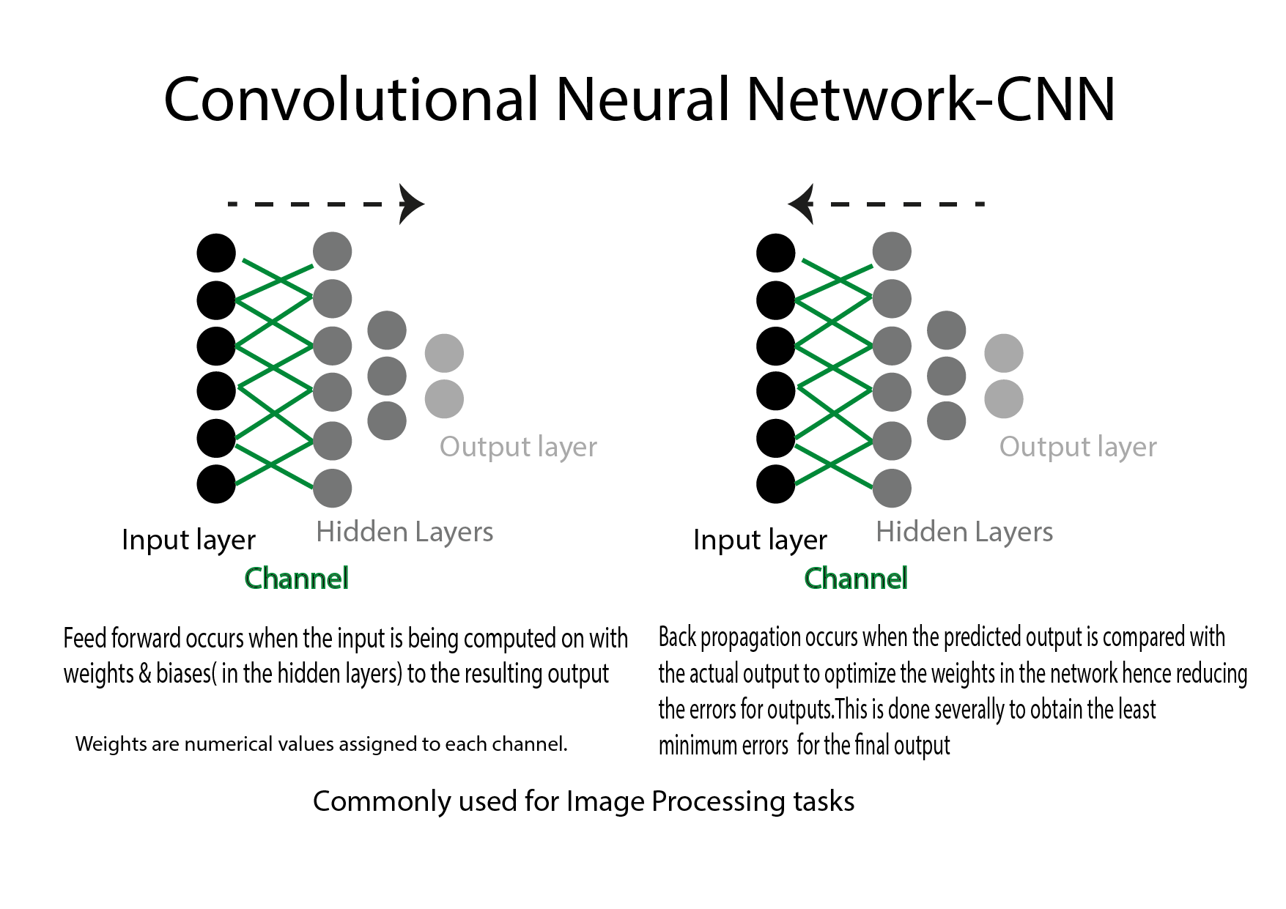
NEURAL NETWORK
03

Slide 5
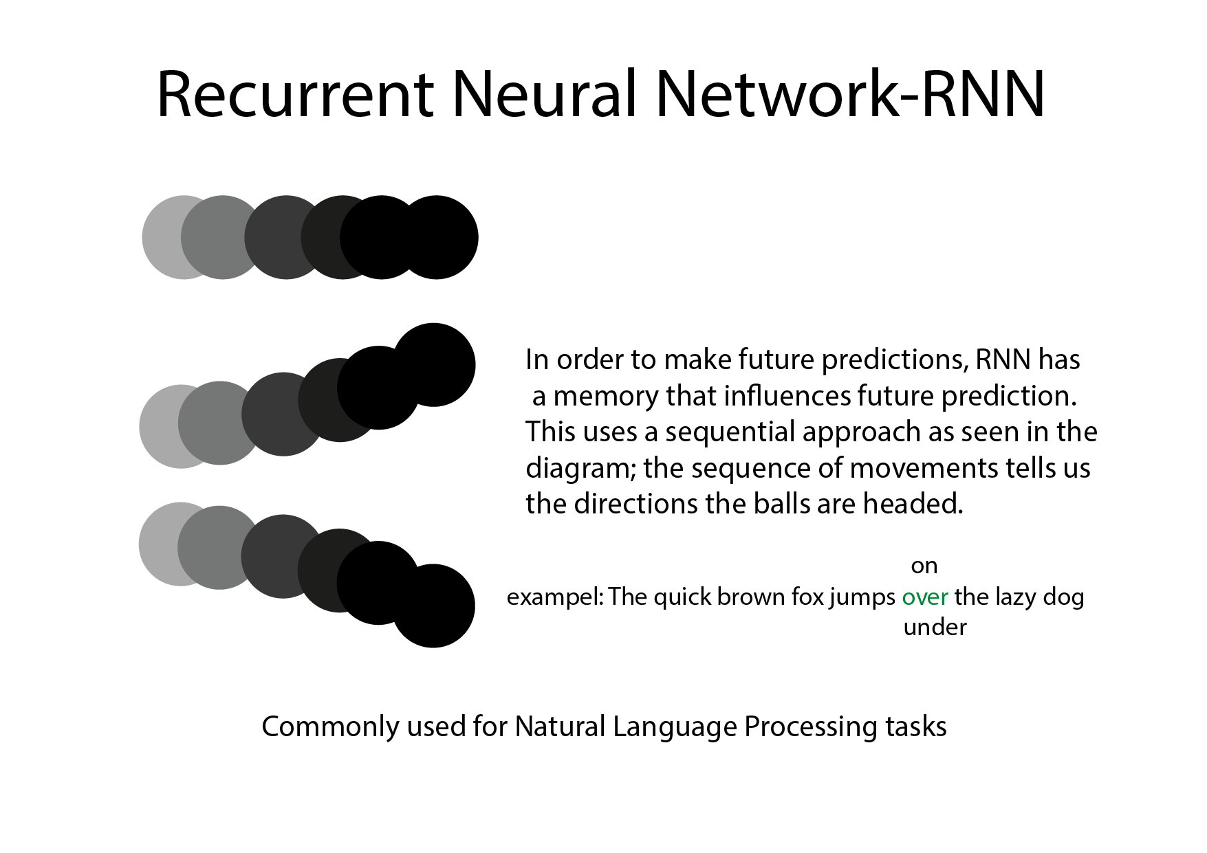
NEURAL NETWORK
04

Slide 6
DEEP LEARNING
Deep learning is a subset of machine learning that makes machines mimic the human brain using Artificial Neural Network(ANN).
For example, an Automatic translator, self driving cars.
05

Slide 7
DEEP LEARNING
Feed forward occurs when the input is being computed on with weights & biases( in the hidden layers) to the resulting output.
Back propagation occurs when the predicted output is compared with the actual output to optimize the weights in the network hence reducing the errors for outputs. This is done severally to obtain the least minimum errors for the final output.
06

Slide 8
BENEFITS OF AI
The benefit of AI is that it can smartly solve problems quickly provided that during the AI lifecycle, it wasn’t influenced by factors like bad data or biased data. For example, there’s an offshore oil company that would have taken decades to solve a particular problem but the infusion of AI solved it in 2 to 4 days. Which company wouldn’t like to take advantage?
I also think there would be reduced depression and deaths especially with the advent of social chatbots that mimic human interactions giving that humans are social beings.
Notwithstanding the positive sides, poisoning the AI with wrong data would be a threat especially in the health sector where there is a false prediction like someone has some sort of cancer which isn’t so is a bad situation no one would like to find him/herself and that is why a professional should be involved in the model’s lifecycle process to mitigate unfairness and encourage explainability and traceability of model’ predictions/ inferences. Job loss is one key thing when AI is infused in automation/ robots and other services. We’ve heard of companies laying off thousands of workers because they introduced AI in their production line and companies collapsing because AI is changing the way things are made and done.
07

Slide 9
APPLICATIONS OF ARTIFICIAL INTELLIGENCE IN TECHNOLOGY?
AI is unknowingly used by a large percentage of the world in our daily activities especially our interactions with some apps like google maps, Snapchat, Gmail, Uber, Facebook, and the likes and using other products and services of the GAFA ( Google, Amazon, Facebook, Apple) and Microsoft.
08

Slide 10
HOW IS ARTIFICIAL INTELLIGENCE EVOLVING?
Ai is evolving at a very great speed, I would say at an astronomical speed and it does that by intelligently learning to optimize human systems/ data; from education, transports, health, and to doing other sophisticated operations that wouldn’t have been possible given the limited abilities of humans.
09

Slide 11
ARE THERE CATEGORIES OF ARTIFICIAL INTELLIGENCE?
Ooh yes, there are.
Artificial Narrow intelligence-ANI which performs one task like Siri and the likes, Artificial General intelligence-AGI which performs intelligently any tasks as humans and Artificial Super Intelligence -ASI which is thought to be smarter than the combined intelligence of everyone including the most intelligent people ever to have lived on this planet.
10

Slide 12
AI MYTHS
Ai will take over every job?
I think humans are very creative and can easily adapt to new ways of doing things, humans can always create new job avenues.
The end of the world?
I don’t think ASI would mean the end of the world especially when ASI learns to coexist with humans just like our pets and plants do with us. (Compliment humans).
11

Slide 13

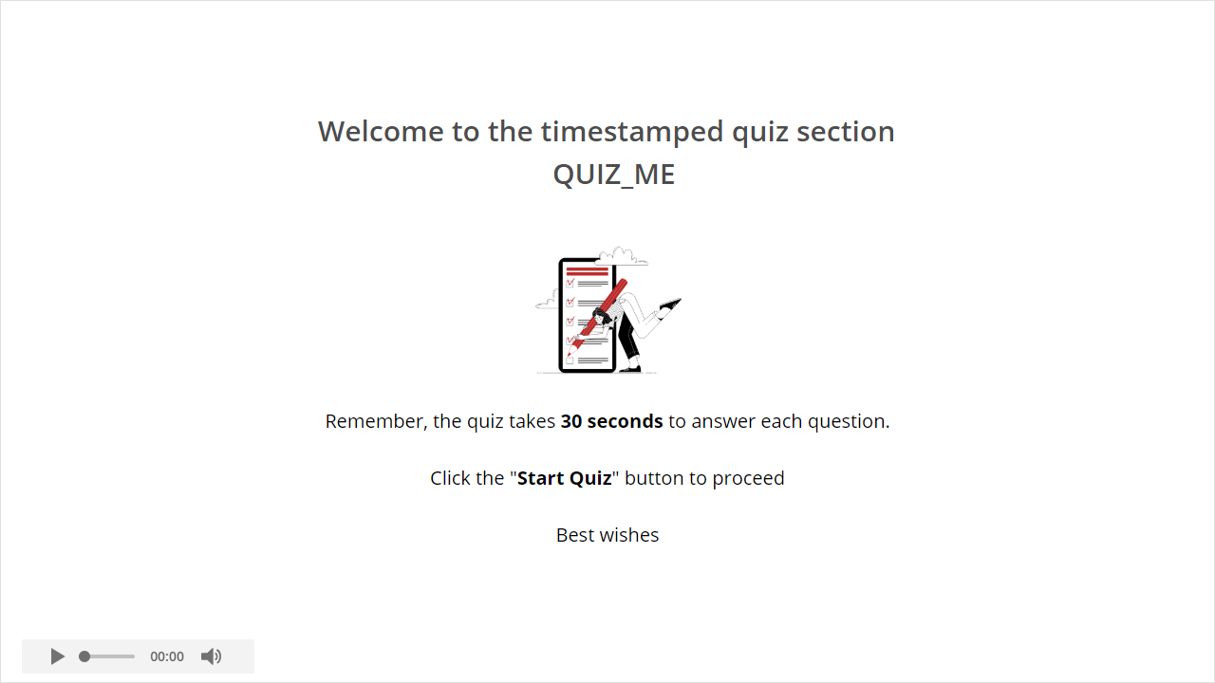
Quiz
IS AI A THREAT
Click the Quiz button to edit this object
No in some aspects but Yes, in many ways especially when it becomes too powerful such that it becomes conscious about itself and at that time we would have achieved the Artificial Super Intelligence -ASI which is thought to be smarter than the combined intelligence of everyone including the most intelligent people ever to have lived on this planet.
I think this is an issue people should be much concerned about and I presuppose that all parties and experts involved must have some regulations such that it doesn’t fall in the wrong hands, hence the ethical use of AI.
12

Slide 14
THANK
YOU

